Slide 1
Exploratory DATA Analysis
EDA

Slide 2
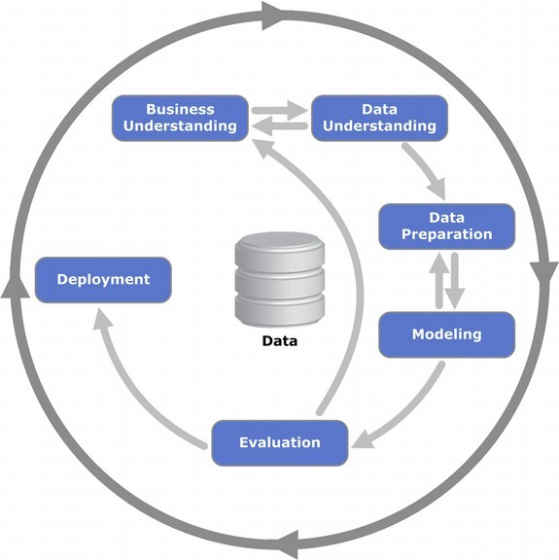
CRISP-DM process
Cross-industry standard process for data mining, known as CRISP-DM, is an open standard process model that describes common approaches used by data mining experts. It is the most widely-used analytics model

Slide 3
CRISP-DM process
Business understanding
Data understanding
Data Preparing
Data Cleaning: Missing value, Noise data,
Data Integration: Different sources, Redundancy
Data Transformation
Data Reduction
Data understanding
Data Mining
Evaluation
Knowledge presentation

Slide 4
So for understanding, explore or cleaning?
When you think about your data,
it might seem logical to explore your data,
find out what’s there and which parts need attention before commencing with the cleaning.
After all, how can you clean up if you don’t know what the mess is?
it’s an iterative process.
You might not be able to explore and find out what you need about the data with it in the wrong format.
Do some back and forth between exploration and cleaning.

Slide 5
Exploratory DATA Analysis (EDA)
Data exploration: an approach similar to initial data analysis, whereby a data analyst uses visual exploration to understand what is in a dataset and the characteristics of the data. These characteristics can include:
size or amount of data,
completeness of the data,
correctness of the data,
possible relationships amongst data elements
Notes:
In statistics, exploratory data analysis (EDA) is an approach to analyzing data sets to summarize their main characteristics, often with visual methods. A statistical model can be used or not, but primarily EDA is for seeing what the data can tell us beyond the formal modeling or hypothesis testing task

Slide 6
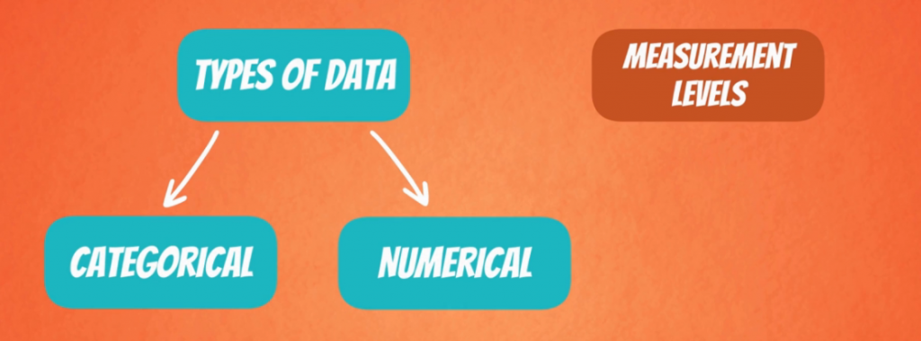
Data Types in Statistics
Data Types are an important concept of statistics, which needs to be understood, to correctly apply statistical measurements to your data and therefore to correctly conclude certain assumptions about it.
Notes:
https://towardsdatascience.com/data-types-in-statistics-347e152e8bee

Slide 7
Categorical Data
Describes categories or groups.
One example would be car brands like Mercedes, BMW and Audi – they show different categories.
Can also take on numerical values (Example: 1 for female and 0 for male).
Note that those numbers don’t have mathematical meaning.
Two types :
Nominal data
Ordinal data

Slide 8

Categorical Data
Nominal Data: represent discrete units and are used to label variables, that have no quantitative value.
Just think of them as “labels”.
Nominal data that has no order..

Slide 9

Categorical Data
Ordinal Data: represent discrete and ordered units.
Nearly the same as nominal data, except that it’s ordering matters.
Difference between Elementary and High School is different than the difference between High School and College (main limitation)
Ordinal scales are usually used to measure non-numeric features like happiness, customer satisfaction and so on.

Slide 10
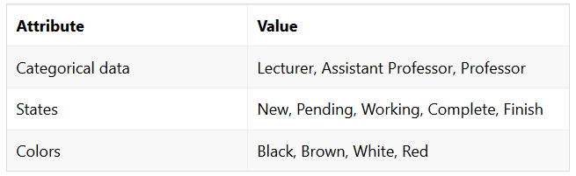
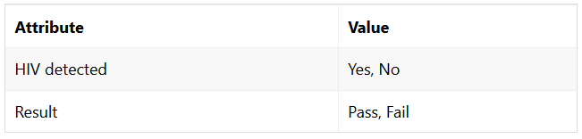
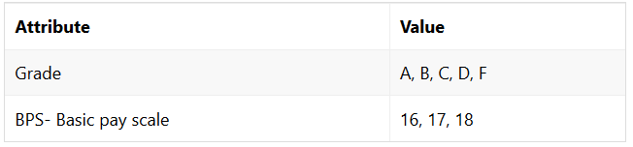
Categorical Data

Slide 11

Numerical Data
Numerical data, represents numbers. It is further divided into two subsets:
discrete
continuous.

Slide 12
Numerical Data
Discrete data: values are distinct and separate.
Data can only take on certain values.
Data can’t be measured but it can be counted.
It basically represents information that can be categorized into a classification.
“Can you count it and can it be divided up into smaller and smaller parts?”
Examples
The number of heads in 100 coin flips.
Grades at university are discrete – A, B, C, D, E, F, or 0 to 100 percent.
The number of objects in general. No matter if bottles, glasses, tables, or cars. They can only take integer values
Money can be considered both, but physical money like banknotes and coins are definitely discrete. You can’t pay $1.243. You can only pay $1.24. That’s because the difference between two sums of money can be 1 cent at most.

Slide 13
Numerical Data
Continuous data: represents measurements.
their values can’t be counted but they can be measured.
An example would be the height of a person, which you can describe by using intervals on the real number line.
Continuous data technically have an infinite number of steps (in a float type there are many number between 0 and 1)
Examples: Apart from weight, other measurements that are also continuous are:
Height
Area
Distance
Time

Slide 14
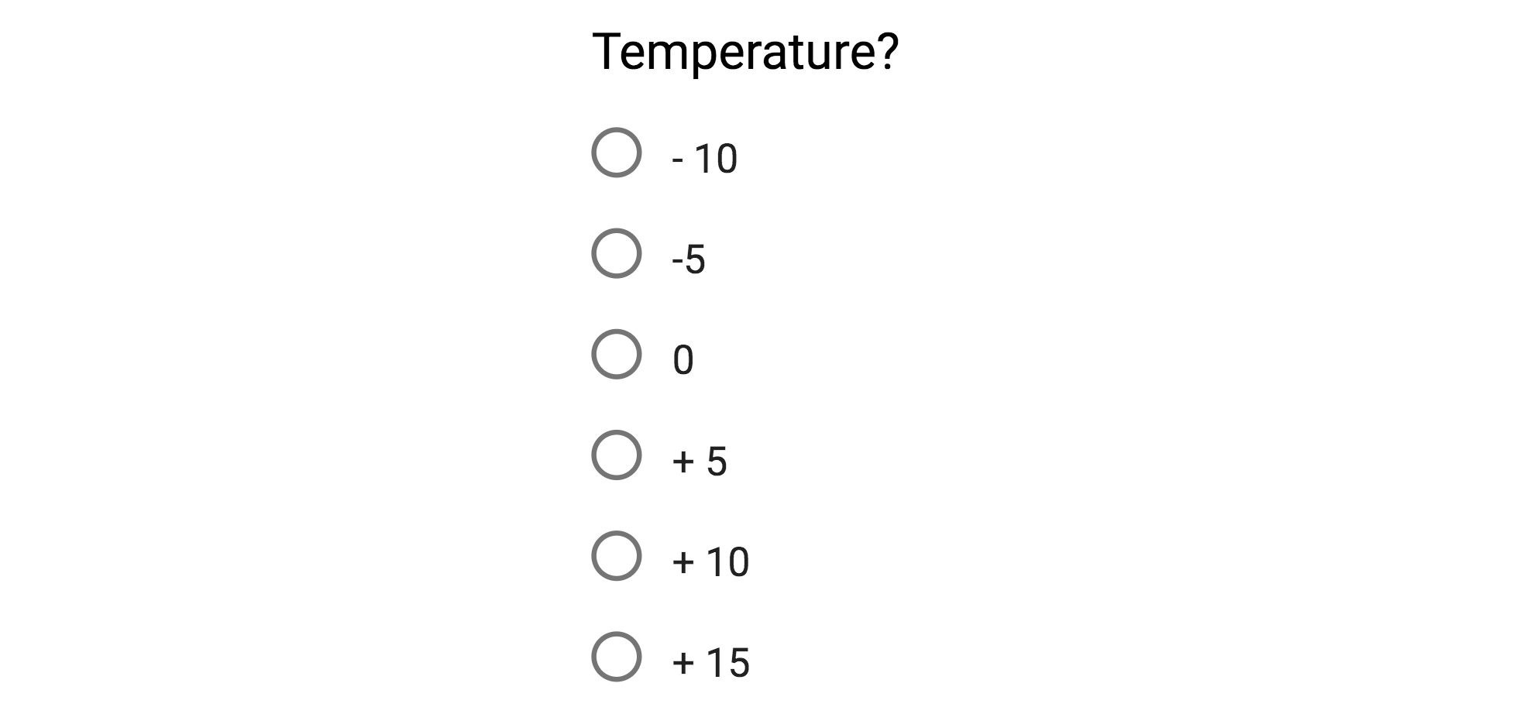

Numerical Data
Some type of continuous data:
Interval-Scaled
Ratio-scaled
Scaled values represent ordered units that have the same difference : Interval (non absolute zero) and radio (absolute zero)
Notes:
https://towardsdatascience.com/data-types-in-statistics-347e152e8bee

Slide 15
Data type
Sometimes we said that:
Categorical data are qualitative
Numerical data are quantitative
Quantitative: The information is recorded as numbers and represents an objective measurement or a count. Temperature, weight, and a count of transactions are all quantitative data. Analysts also refer to this type as numerical data.
When you have a number, doesn't necessarily make it quantitative.
zip codes, phone numbers and bank-accounts are numeric, but it doesn't make much sense to find the average phone number or median zip-code.
Qualitative: The information represents characteristics that you do not measure with numbers. Instead, the observations fall within a countable number of groups. In fact, this type of variable can capture information that isn’t easily measured and can be subjective. Taste, eye color, architectural style, and marital status are all types of qualitative variables.
Notes:
https://towardsdatascience.com/data-types-in-statistics-347e152e8bee
https://statisticsbyjim.com/basics/data-types/

Slide 16
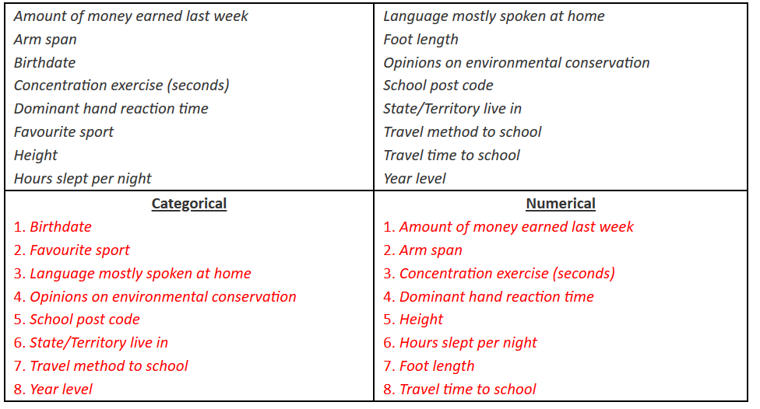
Data type
Notes:
https://towardsdatascience.com/data-types-in-statistics-347e152e8bee
https://statisticsbyjim.com/basics/data-types/

Slide 17
Data type
Notes:
Arm span : bras

Slide 18
How to describe and display data?
Categorical data: tables
Numerical data: descriptive statistics

Slide 19
Tables
Frequency Tables : records the counts of totals and category names
Relative frequency tables: displays the percentages, the counts, of the variables in each category
Distribution-tables or graphical displays: show how variables are distributed across categories.

Slide 20
Contingency Tables
Contingency tables (two-way): presents categorical data by counting the number of observations that fall into each group for two variables, one divided into rows and the other divided into columns.
Class
 | 1st | 2nd | 3rd | Crew | total
Alive | 203 | 118 | 178 | 212 | 711
Dead | 122 | 167 | 528 | 673 | 1490
Total | 325 | 285 | 706 | 885 | 2201
Survival
The totals for each category, also known as marginal distributions, provide the number of individuals in each row or column without accounting for the effect of the other variable
Notes:
http://www.stat.yale.edu/Courses/1997-98/101/catdat.htm

Slide 21
Contingency Tables
1.) Compare the survival rates for each passenger classes.
1st class and survived =
1st class and died =
2.) What percent of the survivors were in second class?
3.) What percent were second-class who survived?
4.) What percent of the second-class passengers survived?
Class
 | 1st | 2nd | 3rd | Crew | total
Alive | 203 | 118 | 178 | 212 | 711
Dead | 122 | 167 | 528 | 673 | 1490
Total | 325 | 285 | 706 | 885 | 2201
Survival
Notes:
http://www.stat.yale.edu/Courses/1997-98/101/catdat.htm

Slide 22
Contingency Tables
Marginal distribution: frequency distribution of one of the variables.
Conditional distribution: shows one variable for just the individuals who satisfy some condition on another variable.
Class
 | 1st | 2nd | 3rd | Crew | total
Alive | 203 | 118 | 178 | 212 | 711
Dead | 122 | 167 | 528 | 673 | 1490
Total | 325 | 285 | 706 | 885 | 2201
Survival
Notes:
http://www.stat.yale.edu/Courses/1997-98/101/catdat.htm

Slide 23
Contingency Tables
Did the chance of surviving the Titanic sinking depend on ticket class? Look at the conditional distributions to answer this.
Class
 | 1st | 2nd | 3rd | Crew | total
Alive | 203 | 118 | 178 | 212 | 711
Dead | 122 | 167 | 528 | 673 | 1490
Total | 325 | 285 | 706 | 885 | 2201
Survival
 | 1st | 2nd | 3rd | Crew | Total
Alive
 | 1st | 2nd | 3rd | Crew | Total
Dead
Notes:
Il faut parler aussi de l’ajout des colonnes dans la dataset pour faire apparaître des notions caché.

Slide 24
Descriptive statistics
Statistics is all about drawing conclusions from data, which is a necessary initial step.
Descriptive Statistics: describing, presenting, summarizing and organizing your data (population), either through numerical calculations or graphs or tables.
Descriptive Statistical Analysis helps you to understand your data and is a very important part of Machine Learning.

Slide 25
DATA Exploration: descriptive statistics
Univariate
Multivariate

Slide 26
Descriptive statistics (One variable)
Frequencies, quantiles and percentiles
Measures of central tendency
Mean
Median
Mode
Measures of spread
Range
Interquartile range (IQR)
Variance
Mean absolute deviation
Median absolute deviation

Slide 27
Descriptive statistics (One variable)
Quantiles are cut points dividing the range of a probability distribution into continuous intervals with equal probabilities: q-quantiles
Some q-quantiles have special names:
The only 2-quantile is called the median
The 4-quantiles are called quartiles → Q
the difference between upper and lower quartiles is also called the interquartile range, → IQR = Q3 − Q1
The 100-quantiles are called percentiles → P

Slide 28
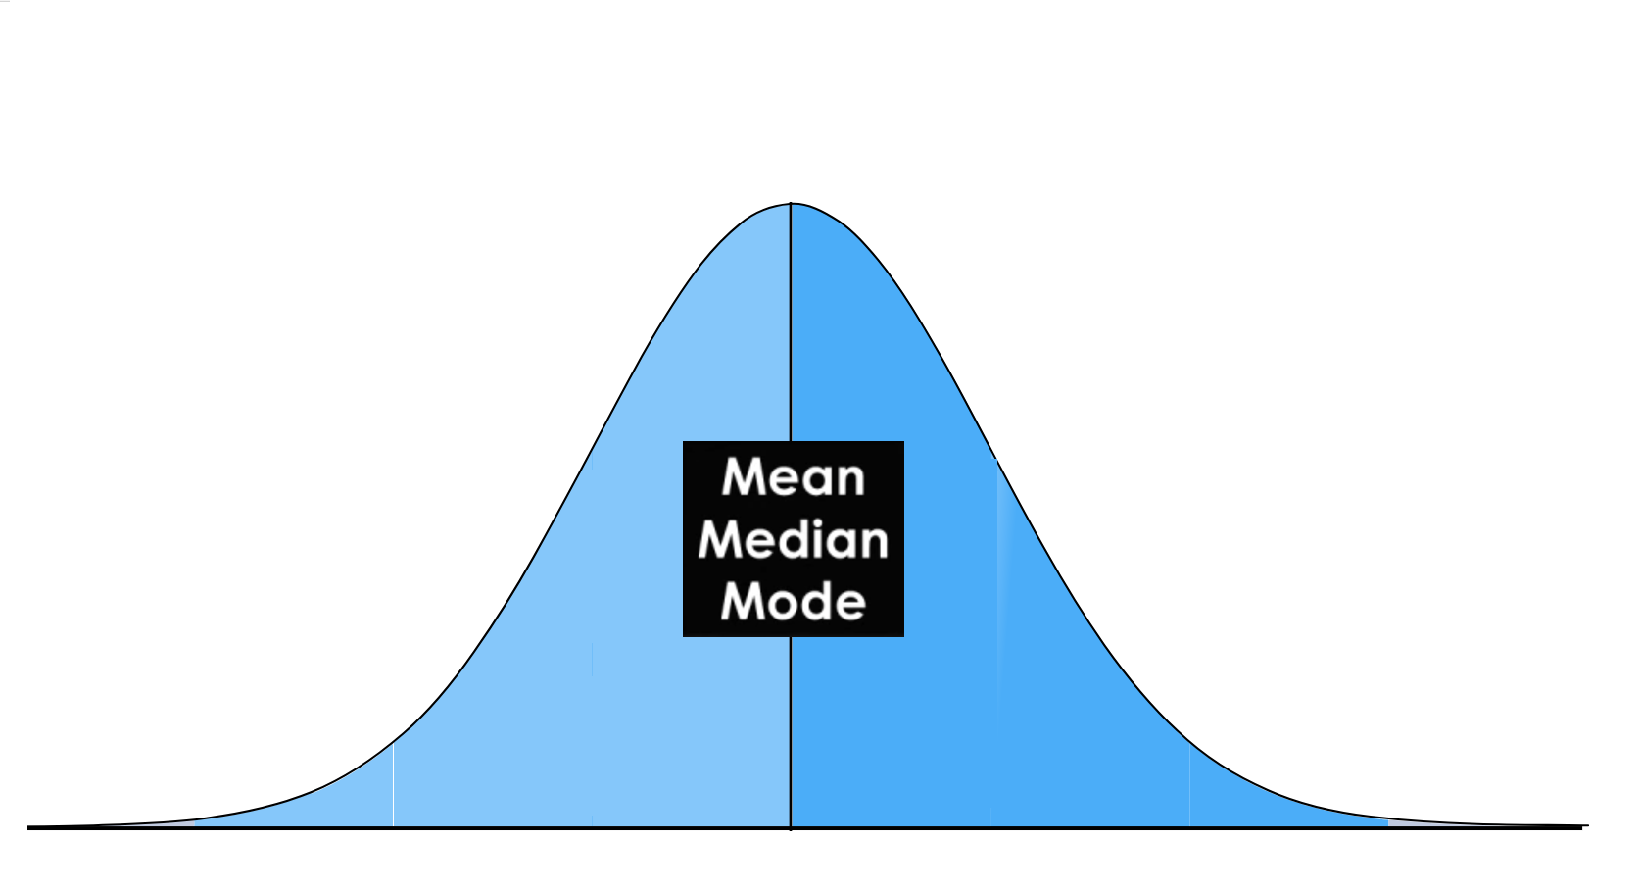
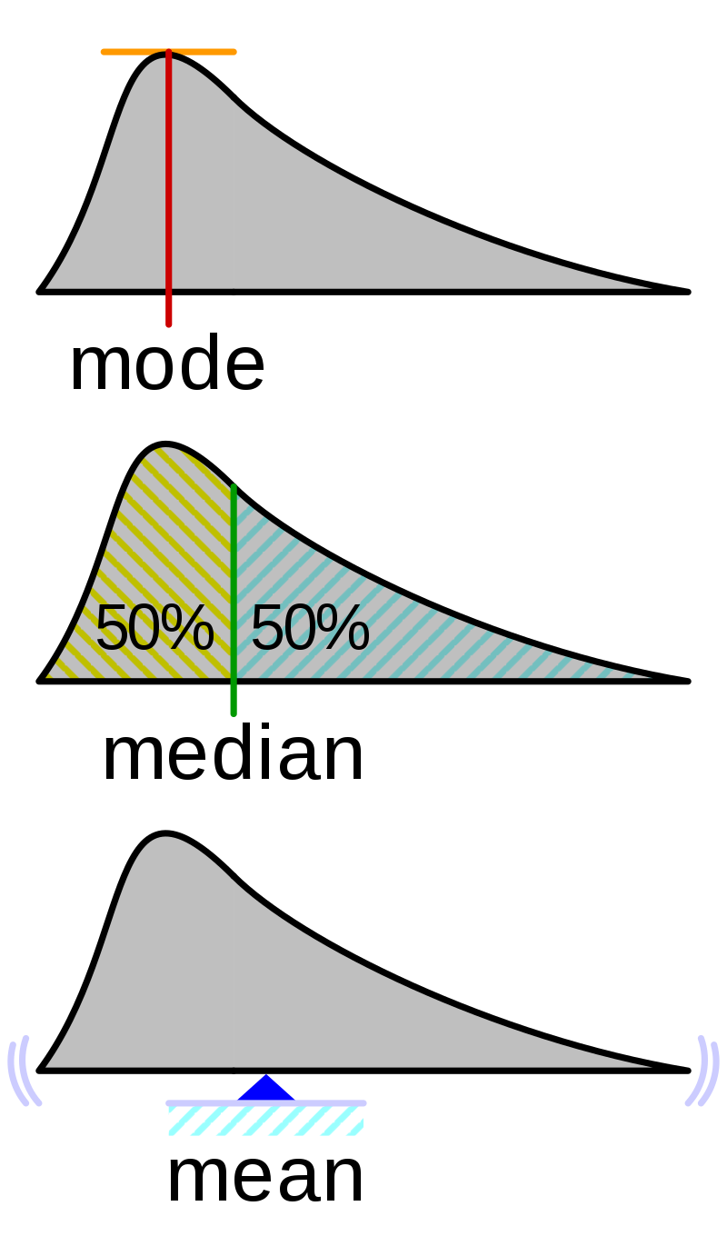
Descriptive statistics (One variable)
Central tendency: Mean, Median, Mode

Slide 29
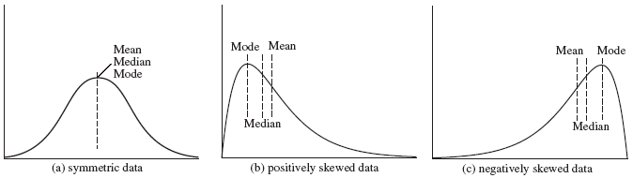
Descriptive statistics (One variable)
Central tendency: symmetric vs skewed data
Notes:
https://towardsdatascience.com/understanding-descriptive-statistics-c9c2b0641291
Most of ML models assume data that is symmetric so data transformation is needed

Slide 30
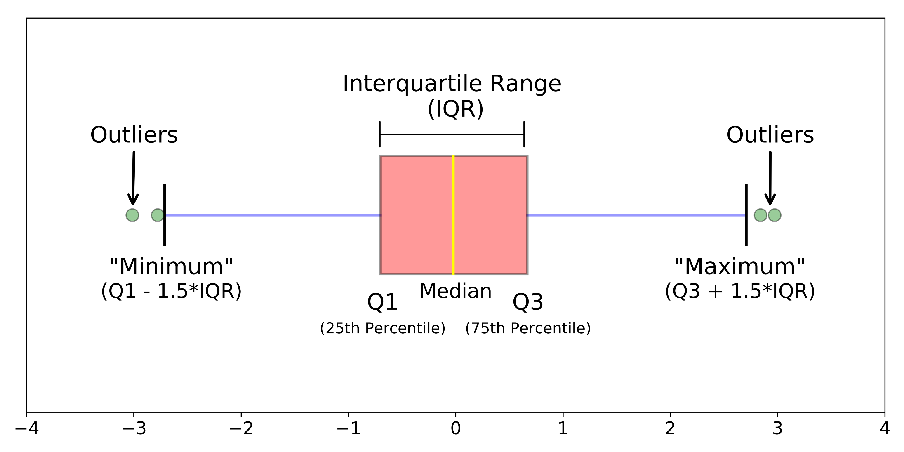
Descriptive statistics (One variable)
Measures of spread: the most popular variability measures are:
Range : difference between the largest and the smallest points in your data.
InterQuartile Range (IQR): measure of statistical dispersion between upper (75th) and lower (25th) quartiles

Slide 31
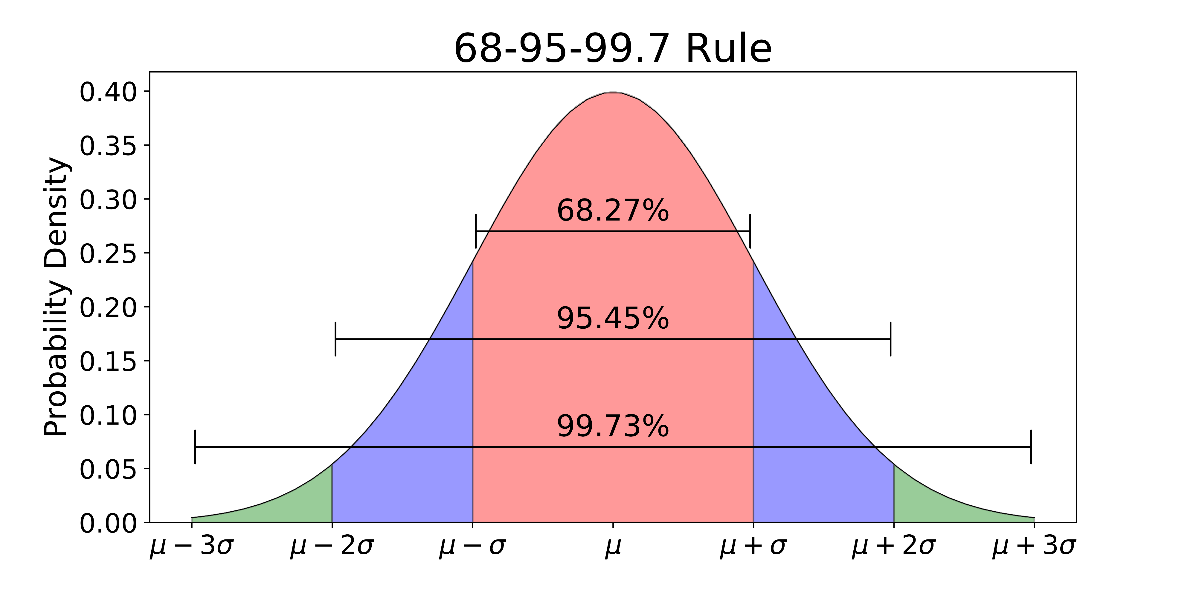
Descriptive statistics (One Variable)
Measures of spread: the most popular variability measures are:
Variance : difference between every data point and the mean, squaring them, summing them up and then taking the average of those numbers.
Standard deviation: square root of the variance

Slide 32
Descriptive statistics (One Variable)
Measures of spread: the most popular variability measures are:
Mean absolute deviation: It is calculated similarly to standard deviation, but it uses absolute values instead of squares to circumvent the issue of negative differences between the data points and their means.
Median absolute deviation: a robust measure of the variability of a univariate sample of quantitative data. D defined as the median of the absolute deviations from the data's median.
Notes:
Standard Deviation vs. Average Deviation Differences
Standard deviation is often used in creating strategies for investing and trading because it can help measure market volatility and predict performance trends. For example, an index fund should have a low average deviation when compared to its benchmark fund. That means it's closely tracking the benchmark, as it's supposed to do. More aggressive funds have a high standard deviation and greater volatility. These funds are high risk and potentially more profitable.
The mean average, or absolute deviation, is used less frequently because the use of absolute values makes further calculations more complicated and unwieldy than using the standard deviation.

Slide 33
Descriptive statistics (Multivariate)
Mean
Covariance matrix
Correlation matrix

Slide 34
Descriptive statistics (Multivariate)
Covariance matrix : measures how much two random variables vary together in a population.
When the population contains higher dimensions or more random variables, a matrix is used to describe the relationship between different dimensions.
In a more easy-to-understand way, covariance matrix is to define the relationship in the entire dimensions as the relationships between every two random variables
Notes:
https://towardsdatascience.com/interesting-properties-and-use-cases-of-the-covariance-matrix-80d72939c7ab
https://www.datasciencecentral.com/profiles/blogs/preprocessing-for-deep-learning-from-covariance-matrix-to-image
- Relationship between the movement of variable, dot product = cov()

Slide 35
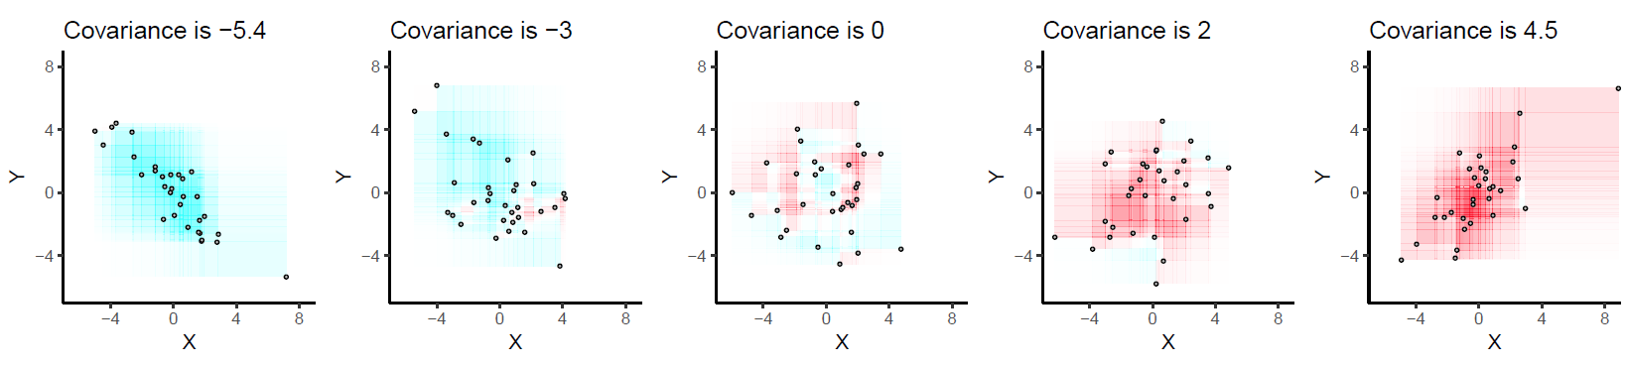
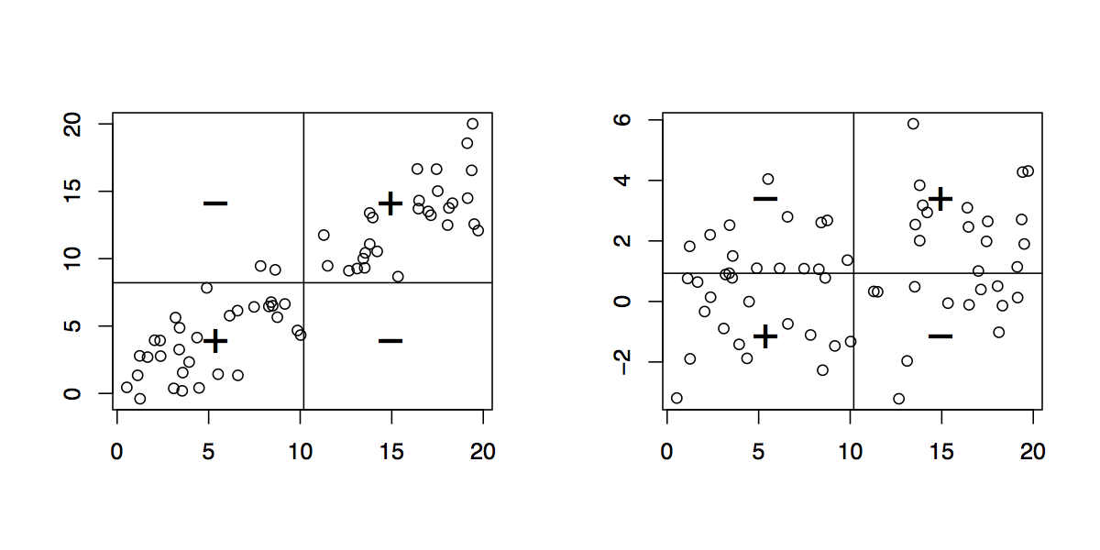
Descriptive statistics (Multivariate)
Covariance matrix :
Notes:
https://towardsdatascience.com/interesting-properties-and-use-cases-of-the-covariance-matrix-80d72939c7ab
https://www.datasciencecentral.com/profiles/blogs/preprocessing-for-deep-learning-from-covariance-matrix-to-image
- Relationship between the movement of variable, dot product = cov()

Slide 36
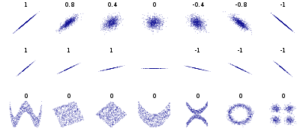
Descriptive statistics (Multivariate)
Correlation matrix: the degree to which a pair of variables are linearly related.
Notes:
Correlation : angle between the two vectors.

Slide 37
DATA EXPLORATION: Visualization
Arrangement
Selection

Slide 38
Visualization (Univariate)
Numerical variables:
histograms
boxplots
These figures would give us an understanding about the variables’ central tendencies and spread.

Slide 39
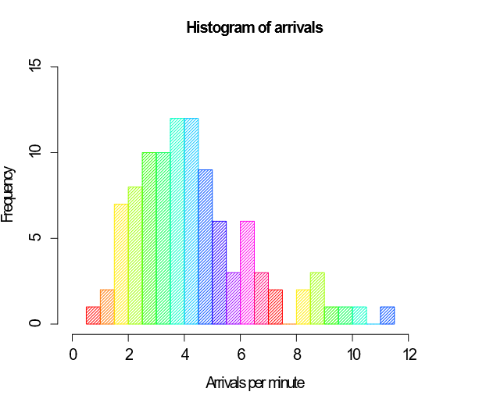
Visualization (Univariate)
Numerical variables:
histograms : an approximate representation of the distribution of numerical or categorical data
the first step is to "bin" the range of values—that is, divide the entire range of values into a series of intervals—and then count how many values fall into each interval.
The vertical axis is the frequency density—the number of cases per unit of the variable on the horizontal axis.

Slide 40
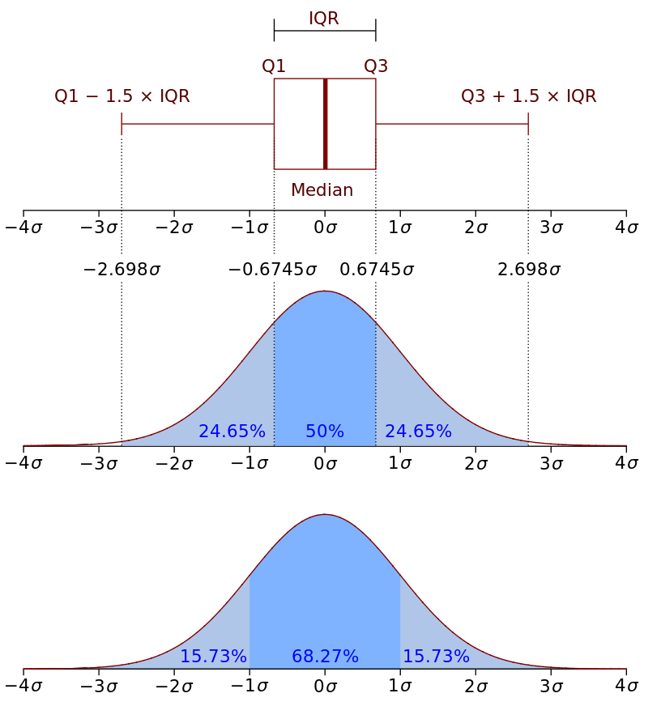
Visualization (Univariate)
Numerical variables:
Box plot: a method for graphically depicting groups of numerical data through their quartiles.
Box plots may also have lines extending from the boxes (whiskers) indicating variability outside the upper and lower quartiles, hence the terms box-and-whisker plot and box-and-whisker diagram.
Outliers may be plotted as individual points

Slide 41
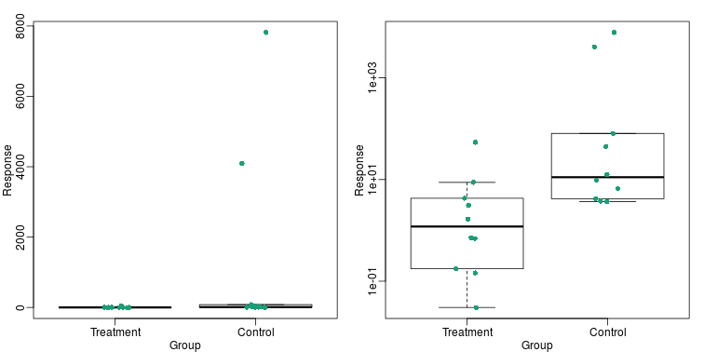
Visualization (Univariate)
Numerical variables:
Box plot: a method for graphically depicting groups of numerical data through their quartiles.
Log scale

Slide 42
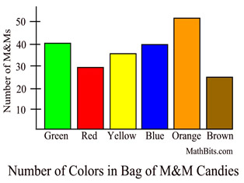
Visualization (Univariate)
Categorical variables:
build a bar chart visualization that shows the frequencies in each category.

Slide 43
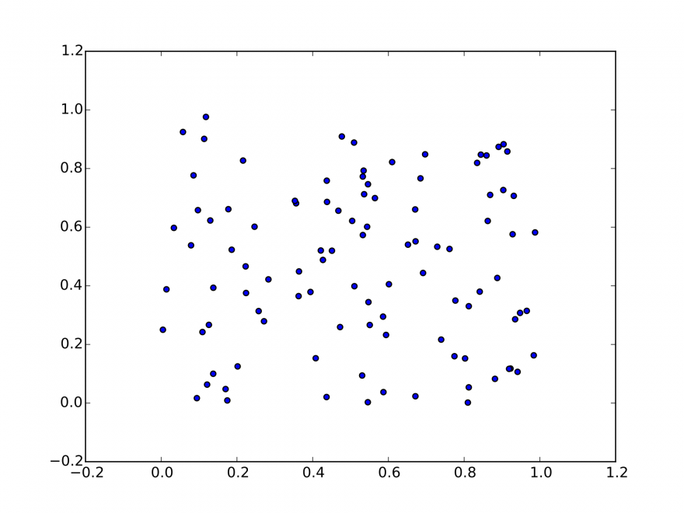
Visualization (Bi-variate)
Continuous & Continuous (Matrix):
scatter plots in order to see how two continuous variables interact between each other.

Slide 44
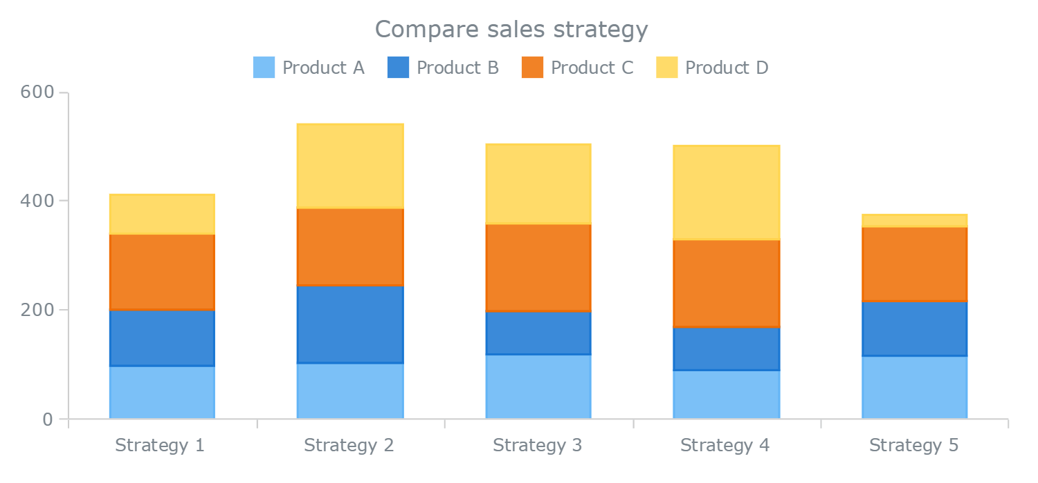
Visualization (Bi-variate)
Categorical & Categorical:
A Stacked Column Chart shows how the frequencies are spread between the two categorical variables.

Slide 45
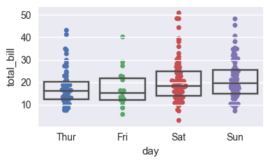
Visualization (Bi-variate)
Categorical & Continuous:
boxplots combined with swarmplots.

Slide 46
Visualization (Multivariate)
Displaying additional dimensions
Size
Color
Shape
Slicing data
Animation

Slide 47
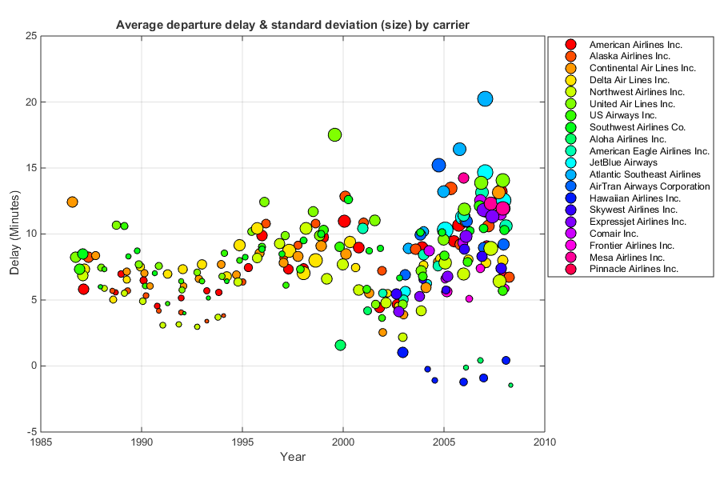
Visualization (Multivariate)
Displaying additional dimensions

Slide 48
Visualization
Higher-dimsional data
Matrices
Parallel coordinates
Star coordinates
Multidimensional arrays
Data cubes
Dimensionality reduction
Pivoting
Slicing/dicing
Roll up/drill down
Notes:
https://towardsdatascience.com/how-to-handle-missing-data-8646b18db0d4
https://www.theanalysisfactor.com/missing-data-mechanism/
https://www.usablestats.com/lessons/noir

